Slide 1


Slide 2

ZERO LECTURE
Advanced Communication Skills-I
PEL 130

Slide 3
OBJECTIVES
Strong grammatical foundation
Building Confidence based on language competence
Impressive Communication skills
Effective comprehension of social and professional world cues.

Slide 4
LTP and credit details
Credits: 3
L-1
T-0
P-3

Slide 5
Course Outcomes
CO1 :: recognize the grammatical elements for appropriate use
CO2 :: understand the usage of language for social and professional purposes.
CO3 :: use key grammatical concepts in written and oral discourse.

Slide 6
Course Outcomes
CO4 :: analyze and correct the place and order of different grammatical elements in verbal communication.
CO5 :: appraise and articulate with effective vocabulary and aesthetically pleasing language
CO6 :: express effectively by becoming more competent in English grammar, writing and speaking

Slide 7
Program Outcomes as specific to the particular course
PO10 Communication::
Communicate effectively on complex engineering activities with the engineering community and with society at large.
Being able to comprehend and write effective reports.
Design documentation,
Make effective presentations,
Give and receive clear instructions.

Slide 8
Before Mid-Term
Unit-1
Parts of Speech
Unit-2
Articles, determiners & quantifiers
Unit-3
Tenses
Course Content

Slide 9
After Mid-Term
Unit-4
Sentences, clauses & direct speech
Unit-5
Modals
Punctuation
Unit-6
Vocabulary
Course Content

Slide 10
Course content
Unit I Parts of Speech :
Different types of Nouns, Noun+Noun,
Different types of Pronuns
Adjectives ending in -ing,-ed, Word order
Difference in Adjectives and Adverbs
Adverbial and Compound Conjunctions,Adjectives+Prepositions
Unit II
Articles, Determiners and Quantifiers :
Rules of Using Articles and determiners,
Names with and without Article ‘The’,
Use of Quantifiers with countable and uncountable Nouns.

Slide 11
Course content
Unit III Tenses :
Compare and Contrast in use of Present and Past, Present Perfect and Past, and Present Perfect continuous and Simple
Use of Have and Have got,
Use ofwill be doing and will have done,
Use of When I do and When I have done.
Unit IV
Sentences, clauses and Direct speech :
Relative clauses with/ without who, that, which
Relative clauses to add extra information
Changes made in direct and Indirect speech
Exceptions to Speech.

Slide 12
Course content
Unit V Modals and Punctuation :
Use of Modal Verbs
Use of Punctuation
Comma between Independent Clauses, Comma for Adding Nonessential Ideas and Nonrestrictive Clauses
Common mistakes made in Punctuation.
Unit VI Vocabulary: phrasal verbs, confusing words :
Phrasal Verbs with up, away and back,
Difference between commonly confused words like:-
Envy and Jealousy,
Different Vocabulary words to replace very.

Slide 13
Course content (Practicals)
Practice worksheets on All Grammar
Topics
➢ Writing Skills: 
Fill-in the gaps on the basis of audio
Speaking Skills: 
Individual Presentation
Listening skills: 
comprehension based on audio
Listening
making inferences and predictions
Reading Skills: 
understanding, locating the main idea, finding supporting ideas, identifying purpose

Slide 14
Practical Applications of the Subject
Grammatical and communicative competence
Effective written and oral communication
Enriched verbal ability, and enhanced vocabulary

Slide 15
Course Assessment Model
Total=100
Class participation:15
CA (4 out of 4 tasks):30
MTE:15
ETE:40

Slide 16
Complete evaluation criteria
Evaluation Type | Objective | Unit Covered | Type | Details of Academic Tasks | Week of conduct
MTE | Ensure desired progress | I, II, III | Objective | 30 MCQs | 8
ETE | To evaluate the achievement of the course outcomes | I, II, III, IV, V, and VI | Objective + Subjective | 30 MCQs + 5 subjective questions (4 to be attempted) * Pattern is tentative | 17

Slide 17
Complete evaluation criteria
CA | Objective | Unit Covered | Type | Details of Academic Tasks | Week of Allocation/ conduct
CA1 | To evaluate students’ ability to solve MCQ | I, II | MCQ | 30 questions based on parts of speech and articles, determiners & quantifiers | 3/4
CA2 | To appraise students’ speaking ability on Speechace | III | Speaking | Speaking task on Speechace | 5/6
CA3 | To ensure enhancement of students’ listening, reading and writing skills | IV | LRW | Evaluation based on video | 10/11
CA4 | To mirrorize students’ grammatical knowledge in writing skills | V, VI | Grammatical writing | Grammar based questions in subjective manner | 12/13

Slide 18
Resources
Text book : English Grammar in Use (4th Edition) by Raymond Murphy, Cambridge University Press.
Reference book : English Grammar and Composition by P.C. Wren and H. Martin, Blackie ELT Books Publishing.

Slide 19
Resources
Referential website Links :
https://www.englishtenses.com/tenses
https://www.englishtestsonline.com/english-grammar-tests/
https://www.grammar-monster.com/index.htmlhttps://www.english-grammar-revolution.com/parts-of-speech.html
https://learnenglish.britishcouncil.org/grammar/english-grammar-reference/determiners-and-quantifiers
https://www.thepunctuationguide.com/
https://dictionary.cambridge.org/dictionary/english/
https://learnenglish.britishcouncil.org/grammar/english-grammar-reference/clause-structure-and-verb-patterns

Slide 20
Resources
Web address for Workshop Videos
https://youtu.be/wiS6e7dYF8A
https://youtu.be/GjUEcVgiq6g
https://youtu.be/l_NYrWqUR40
https://youtu.be/A1siJ0AnI3A

Slide 21
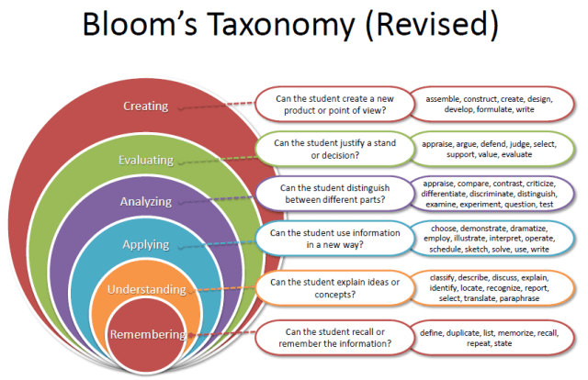
Revised Bloom’s Taxonomy

Slide 22
Students’ Role
Always communicate in English with your friends and in other classes too.
Be enthusiastic in participating in classroom activities and attempt practice tests for better understanding and performance.
Ask volley of questions whenever there arises a doubt in your mind.
Reading enhances speaking, so make the habit of reading newspapers.

Slide 23


Slide 24
Thank you! All the best!

